Slide 1

How did 2020 change music preferences?
An analysis on Italian Spotify users
Final Project
Valeria Minervini

Slide 2



The process
Goal: Observe the effect of covid times on music preferences by analyzing Spotify features.
Data Collection
Data Exploration
Analysis & Visualization
Conclusions
Data scraping
Spotify API
Data cleaning & wrangling
Clustering with machine learning
Cluster analysis
Tackling seasonality
Have music preferences changed?
Future improvements

Slide 3

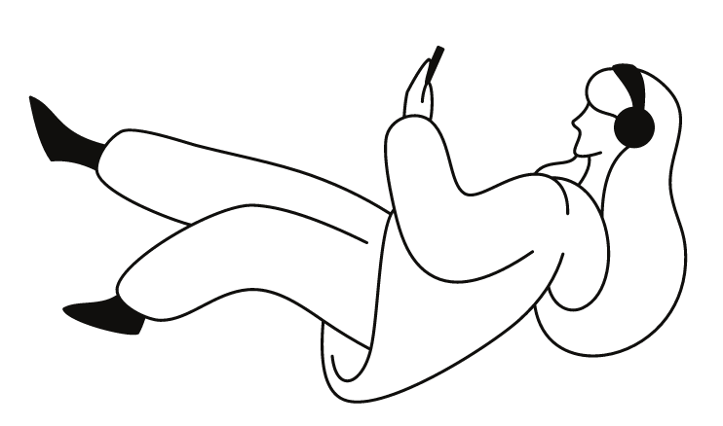
1. Data Collection
1
Web scraping
From the daily Top 200
SpotifyCharts playlist between 12/2018 - 12/2020.
2
Spotify API
Downloaded Spotify features for all the songs.
SONG ID
3
Result:
170800 song information ( Title, Artist, Song ID, Chart Date, Streams)
6 features: (Danceability, Energy, Acousticness, Liveness, Valence, Tempo)
Why these features?
To check for variability in the course of the 2020, I decided to use features that could be related to mood as potential instruments to represent the effect of covid, and in particular of the lockdown.

Slide 4
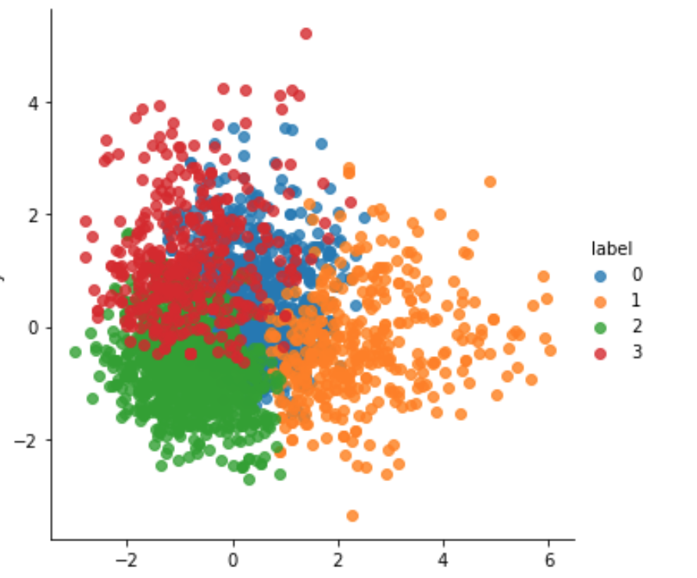
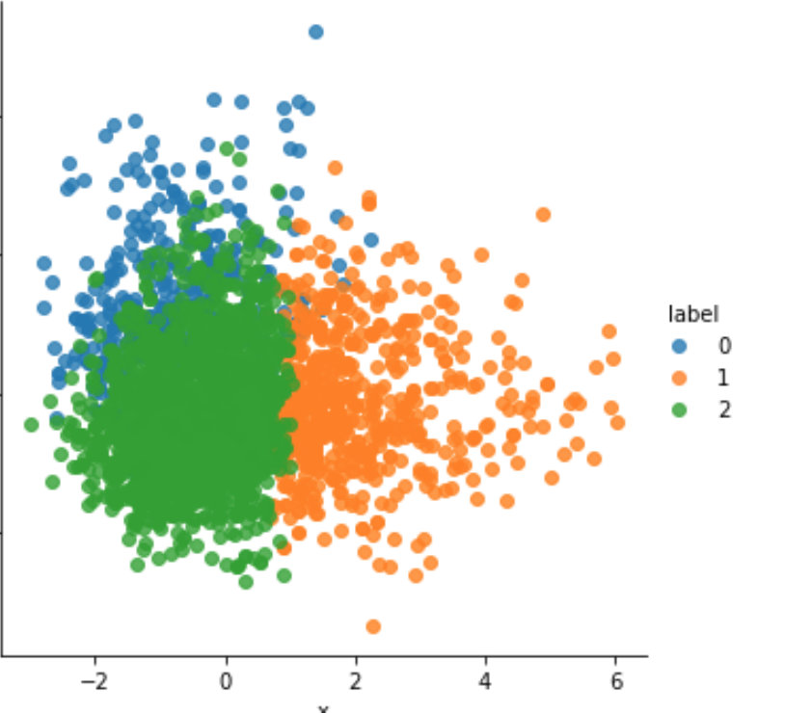
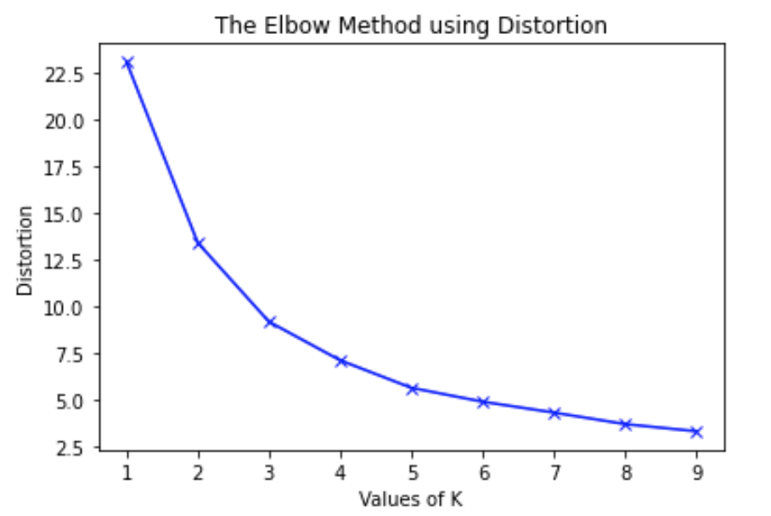
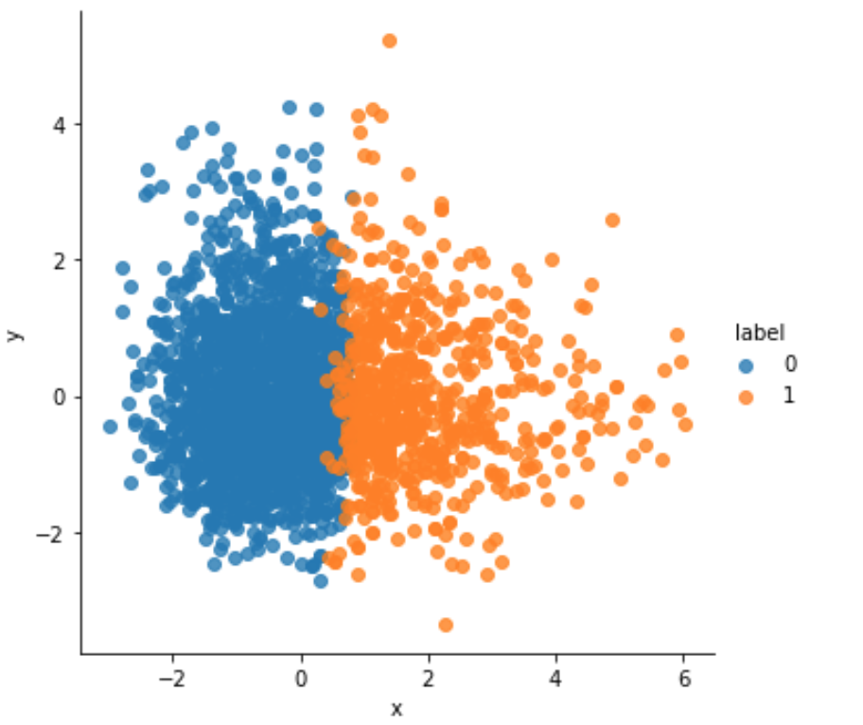
2. Clustering with the K-Means Model
Why choosing 2 clusters makes sense?
Elbow method: the distortion drops until k=3 and sharply flattens after k=5. Complexity/accuracy trade off: more than K=2 did not add value.
Low diversification in the playlist: mainly urban music, i.e. trap, rap and similar on one side (source: analysis by “Il sole 24 ore”), and more pop, ”sad” or “romantic” songs on the other.
This division is also confirmed by the analysis in the next slide
4 clusters: clear overlap.
Difficult to find differences between the clusters.
3 clusters: better, but slight overlap between 0 and 2. They are very close for the avg. valence and avg. energy.
2 clusters: a clearer separation between the two groups.
Notes:
Distortion= sum of squared distances from the center of the cluster. Less distance higher accuracy. Trade off between complexity and accuracy.

Slide 5
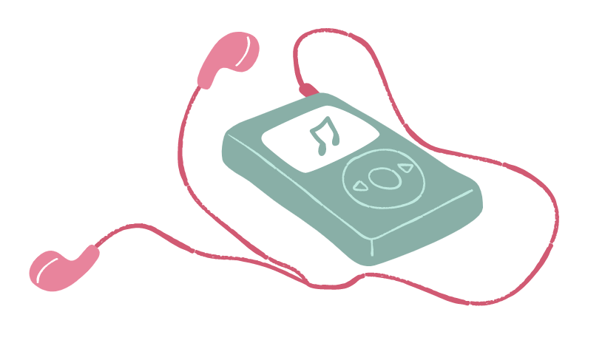
2. Clustering with the K-Means Model
High energy/ ”angry” songs
Avg. energy: 0.71
Lower energy / “sad” songs
Avg. energy: 0.5
Avg. valence: 0.53
Avg. danceability: 0.70
Avg. valence: 0.34
Avg. danceability: 0.57
Most close to urban music.
Close to pop/indie music, mostly perceived as sad.
Notes:
No relevant differences between acousticness, instrumentalness, tempo and
liveness across the two groups.
Interpretation of features done using Spotify definitions or personal assumptions
In particular, after some trial and error, I assumed that if:
Valence > 0.8, there is perception of happiness
.35 < Valence < 0,8 there is perception of anger
Valence <= 0,35 there is perception of sadness

Slide 6
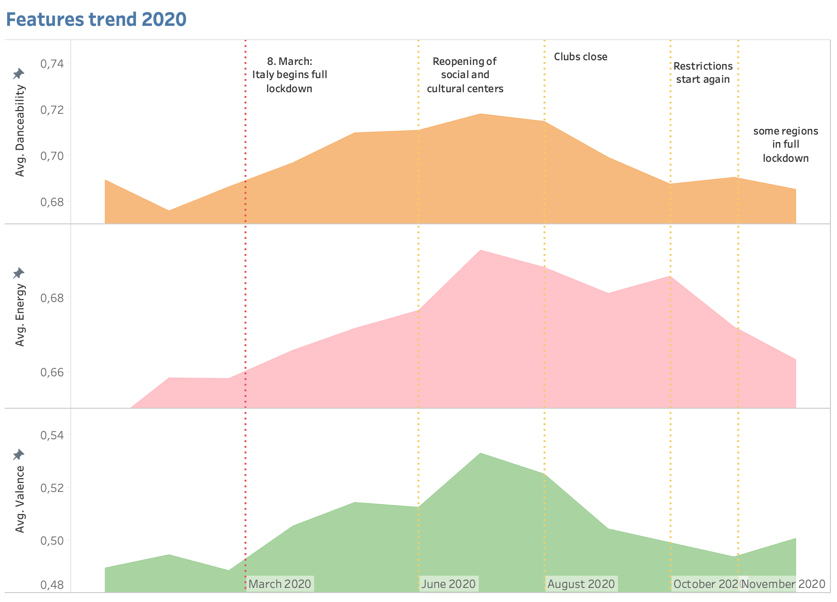
3. The analysis – single features trend
Selected features:
Danceability: hints at a cheerful/party time
Energy: rate of speed, loudness, and noise Valence: perceived positivity in a song
Preliminary observations:
Small, continuous increase in valence/energy music consumption during lockdown
All features peak in July. Small correlation(0.2)
Different, negative trend after the beginning of the second wave
Challenge: Increased preference for cheerful, energetic and danceable songs coincides with spring and summer.
Trends due to seasonality or Covid measures?

Slide 7
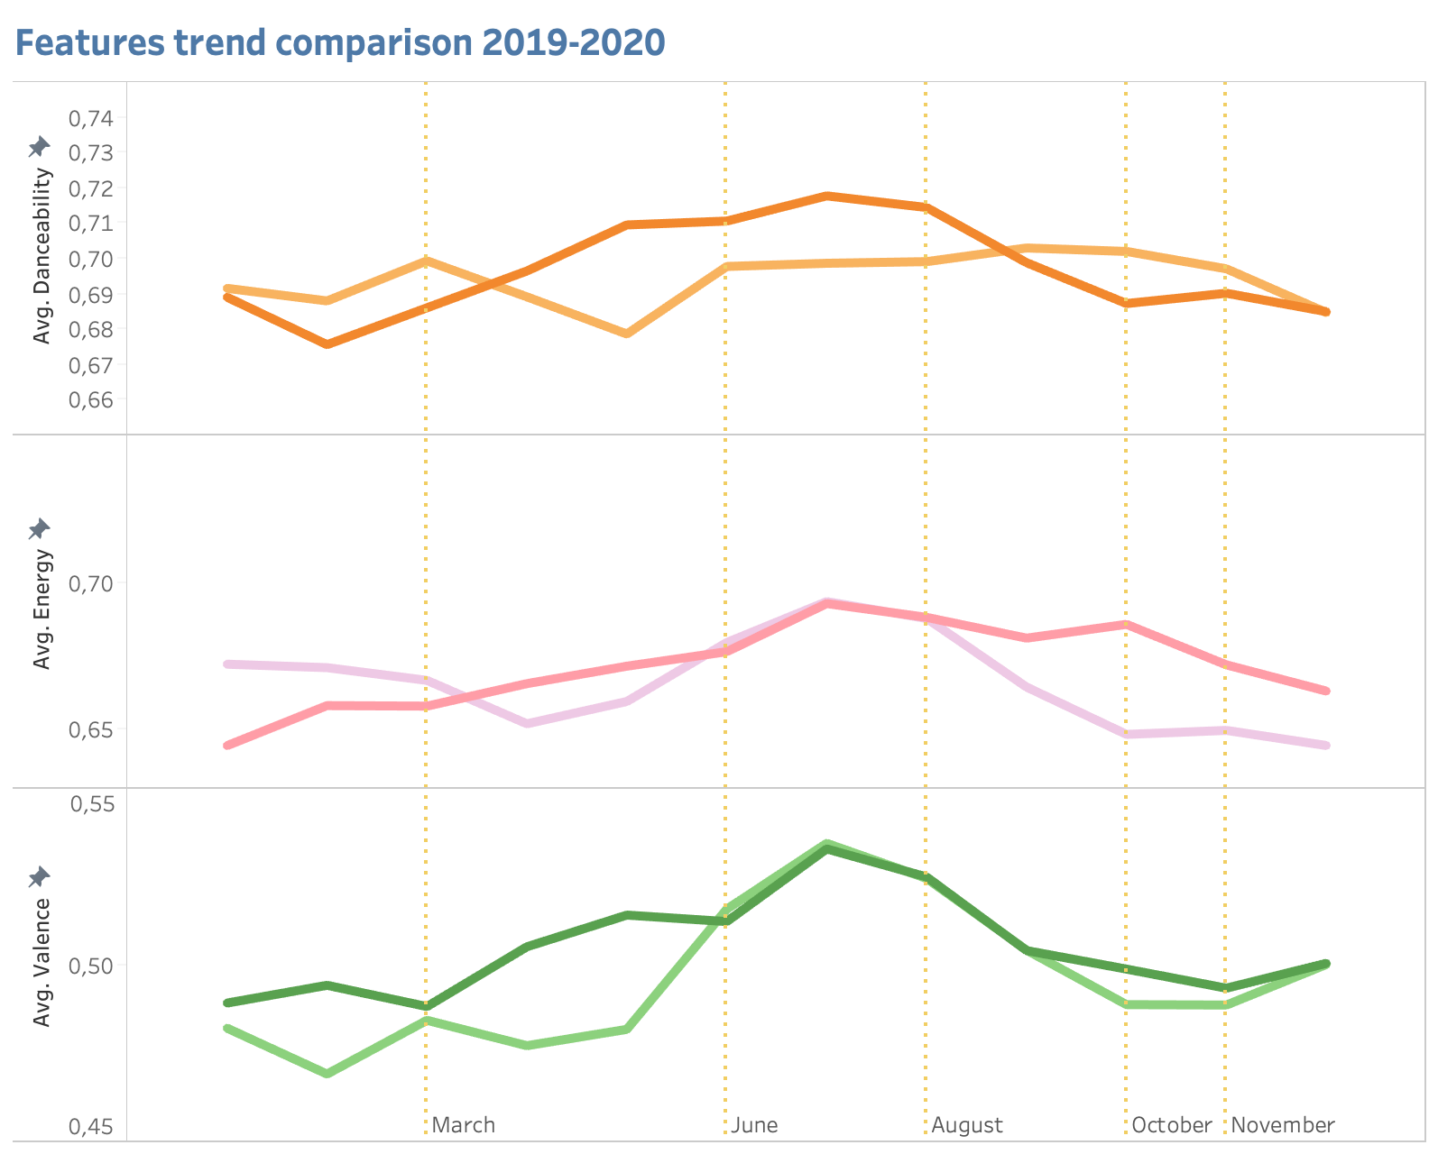
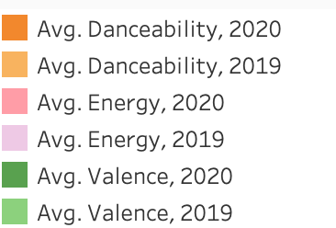
3. The analysis – tackling seasonality
Key takeaways
2020 trends seem to converge with the 2019 trend in both summer time and winter time
However trends diverge between March and June, i.e. lockdown period
Valence is the most deviating from 2019 out of the three features
In general, lack of confidence regarding the meaning of these variations. How to measure a 3% increase in features?

Slide 8
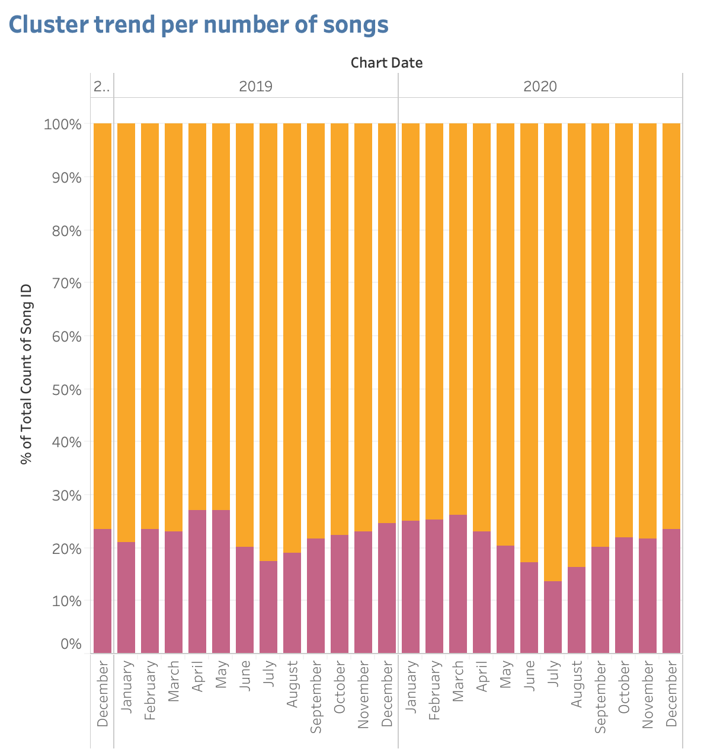
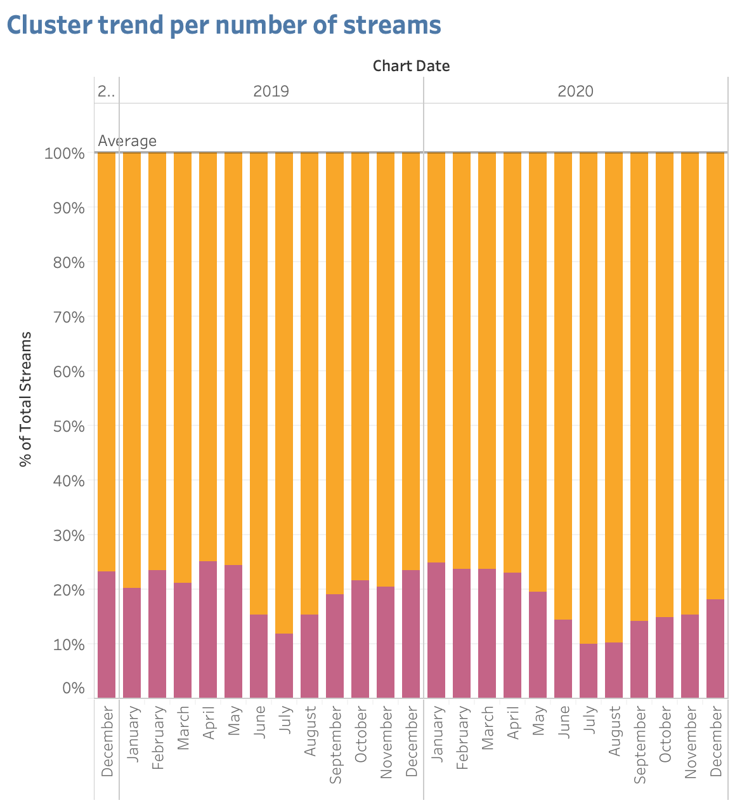

3. The analysis - visualizing the clusters
Increase in high energy/”angry” songs between March-August
Yellow cluster’s peak per number of songs is 4% more in July 2020 than in July 2019. In general, high energy songs increase in summer time, and decrease more slowly in 2020 compared to 2019
Randomness? Difficult to say at the moment, but too little variation to trust it is significant

Slide 9
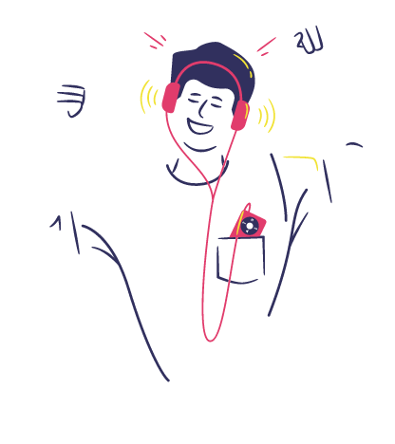
4. Conclusions & Future Developments
Conclusions:
Italian Spotify users might have listened to higher energy songs.
The trend was higher in 2020 than in 2019, hinting at a correlation with the lockdown, when Italian citizens were forced to stay at home. However, this is just a “to be tested” hypothesis, as the difference was very small.
The “higher positivity” though does not mean cheerful sounds, but rather “stronger” and
more “angry” ones. This is probably related to the prevalence of urban music
in the national playlists (from: “Il Sole 24 ore”).
Next steps:
This analysis was not sufficient to understand features and clusters properly. What does actually a % increase mean?
Defining whether a song is “angry” or “sad” : to be supported by NLP
Run hypothesis testing to calculate the significance of the difference between years
Diversity: Choosing spotifycharts did not offer much in the song genre. It would be interesting to extend the analysis to more alternative/indie music charts.

Slide 10
5. References
Web scraping – getting the daily 200 songs including track name, artist, date, songID and streams.
Jennifer Franklin’s
https://medium.com/the-innovation/how-to-scrape-the-most-popular-songs-on-spotify-using-python-8a8979fa6b06
Inspiration and visualization of clusters
Sylvester Cardorelle
https://towardsdatascience.com/predicting-my-mood-using-my-spotify-data-2e898add122a
Animations
Canvas

Slide 11
Thank you!

